Slide 1
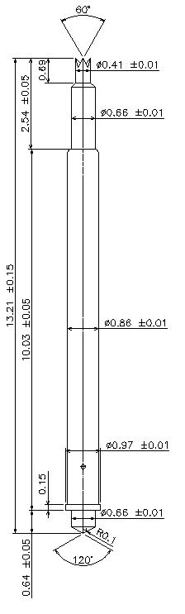
※ POGO type – 13.21mm / 1.8P
IVB-DZR-1321-086-A216-00
Pitch | 1.8mm
Total Length | 13.21mm
Use Length | 11.21mm
Recommended Stroke | 2.0mm
Max Stroke | 2.5mm
Spring Force at Use Stroke | 60gf at 2.0mm Stroke
Operating Temperature | -40 to 125°C
DC Resistance | Avg. <100mΩ at 2.0mm stroke
Current Rating | 3.0A
Self Inductance | - nH
Bandwidth @ -1dB | - GHz
Top Plunger | BeCu / Au
Bottom Plunger | BeCu / Au
Barrel | Phosphor bronze / Au
Spring | Music Wire / Au
Insertion Life | 100,000 cycles at 2.0mm Stroke

Slide 2
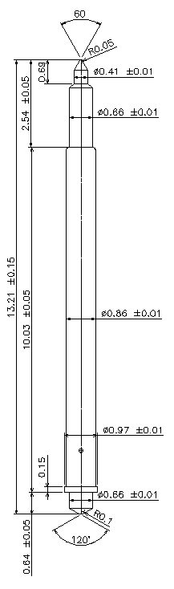
※ POGO type – 13.21mm / 1.8P
IVB-DPR-1321-086-A217-00
Pitch | 1.8mm
Total Length | 13.21mm
Use Length | 11.21mm
Recommended Stroke | 2.0mm
Max Stroke | 2.5mm
Spring Force at Use Stroke | 60gf at 2.0mm Stroke
Operating Temperature | -40 to 125°C
DC Resistance | Avg. <100mΩ at 2.0mm stroke
Current Rating | 3.0A
Self Inductance | - nH
Bandwidth @ -1dB | - GHz
Top Plunger | BeCu / Au
Bottom Plunger | BeCu / Au
Barrel | Phosphor bronze / Au
Spring | Music Wire / Au
Insertion Life | 100,000 cycles at 2.0mm Stroke

